Slide 1
Sales Playbook
Insert Partner Logo
Sell More of Your OWN Products and Services with LINGA ROS.

Slide 2
Sell More with Us!
Table of Contents
Page | Title
03 | Company Background
04 | Submitting Leads
05 | Process Steps
11 | Contacts and Resources
How to Sell More with Us.

Slide 3
Company Background
Used by restaurants and franchises all over the world, LINGA rOS® is the world’s first enterprise-ready cloud-based restaurant operating system that offers convenience, ease of use, and technology.
Including a set of integrations such as Point of Sale, Self-Service Kiosk, Loyalty Rewards Program, Inventory Management, Kitchen Display System, Customer Display System, Waitlist, Cloud Kitchen, Caller ID, Scheduling, & Call Center, our restaurant operating system is an innovative response to the demand for a one-stop solution for restaurant owners.

Slide 4
The Sales Process.
Step by Step
Photo by Scott Graham - Creative Commons null
Photo by Gabriel Gonzalez - Creative Commons null
Photo by Florian Klauer - Creative Commons null
Photo by krakenimages - Creative Commons null
Register Your Lead
Book a DEMO
Quote
Follow Up to Close
Protects You and Your Book of Business.
Book it Directly With Your Sales Rep or through the Website.
Plan to attend.
LINGA Sales Rep will Create the quote with all equipment and subscriptions.
Follow up with your merchant contacts frequently until the deal is closed.

Slide 5
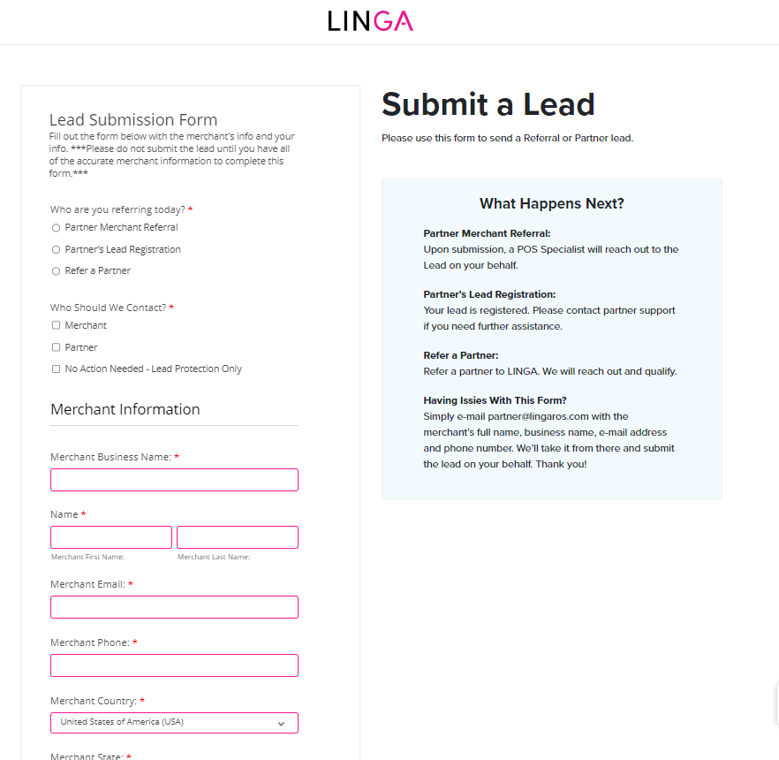
brandnme.
Submit Your Lead
1. Submit your lead: internally to (your person)
2. Protect your lead: submit to LINGA
3. Enter the Required Merchant Info
Submit a Lead
Why Do I Need to Do This?
https://www.lingaros.com/partners/partner-portal/

Slide 6
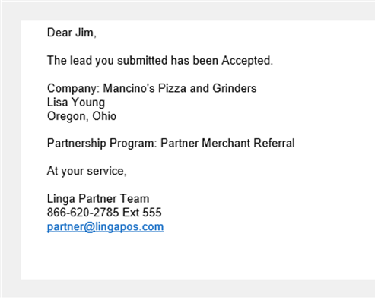
Lead Engagement from LINGA
Your Notification
Our Promise to Follow Up
Once the Lead is approved the referring sales representative will receive an email from LINGA.
Your lead is now protected from being called on by the LINGA direct sales team.

Slide 7
LINGArOS.com
The Deal is Closed!
Congratulations:
Photo by Scott Graham - Creative Commons null

Slide 8
Time to Integrate.
Meet the Team
Steven Pulizzotto
James
Vasu
Project Manager
Marketing
Specialist
Product Designer

Slide 9
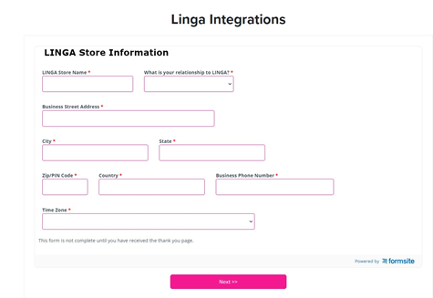
Integration
LINGArOS.Com
Agent or Referral Partner Sales Rep will need to fill out LINGA's integration form with all of the appropriate information.
Your Done!
https://www.lingaros.com/forms/linga-integrations/

Slide 10
enjoy.
Thank you
Contact us
Leave your audience with a quick final thought that encapsulates you, your company, or this presentation.
Sales: 1-800-619-5931
Support: 1-833-MY-LINGA
Email: you@LINGArOS.com

